Slide 1
Bain and Company Employee Attrition
By Imen khemaissia

Slide 2
Why Attrition Matters?
Employee Attrition Prediction is crucial for:
Retention Strategies: Proactively engaging with employees planning to leave to address concerns, provide incentives, and offer growth opportunities.
Workforce Planning: Identifying potential attrition to plan for resource gaps through hiring replacements or developing succession plans.
Project Continuity: Maintaining workflow and project timelines by anticipating and addressing the departure of highly skilled employees through knowledge transfer, cross-training, or timely hiring.
Optimal Hiring: Adjusting hiring strategies based on employees intending to leave to ensure a smooth transition and prevent skilled resource shortages.
Retaining Valuable Assets: Taking targeted actions to retain valuable employees by addressing concerns, providing growth opportunities, and offering competitive compensation.

Slide 3
Objectives
Finding the factors behind employees to attrition from the data provided using predictive modeling.
Provide recommendations to prevent employees from attrition.

Slide 4
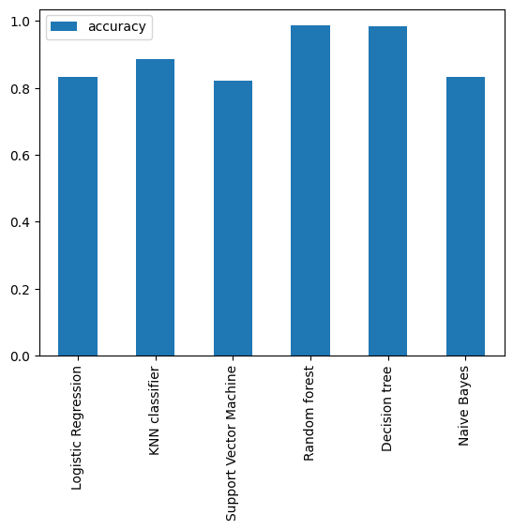
Methodology
For our predictive model, we assessed six different models and ultimately chose the one that demonstrated the highest level of accuracy(Random Forest).

Slide 5
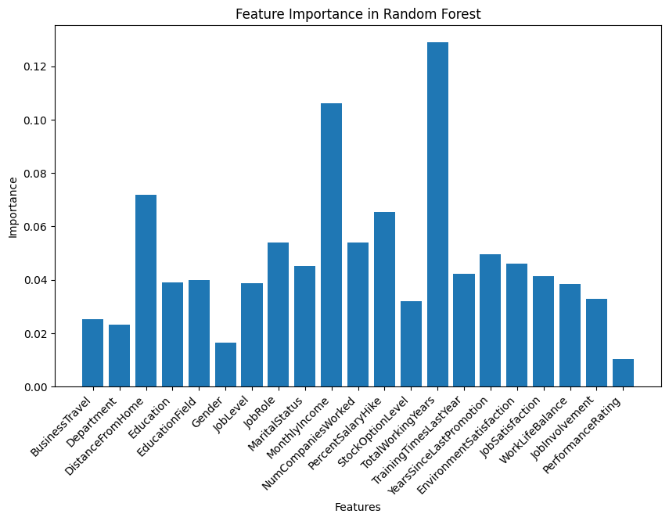
Feature importance
Top 3 Global Feature Importance
Total Working Years
Monthly Income
Distance From Home

Slide 6
Recommendations
Based on the factors of Total Working Years, Monthly Income, and Distance From Home, here are some recommendations to help minimize employee attrition:
Career Development Opportunities: Provide opportunities for employees to advance their skills and
grow within the organization.
Competitive Compensation: Ensure that employees are fairly compensated for their work, considering factors such as industry standards, job responsibilities, and market conditions.
Balance: Promote a healthy work-life balance by offering flexible work arrangements, such as remote work options or flexible scheduling.

